Slide 1


Linux for Beginners
Presented by Linux Club
Get all presentation resources here:
git.bglinux.club/BGLinuxClub/Intro-to-Linux-Presentation/

Slide 2
Agenda
Introduction
Anatomy Of A Command
Everyday Commands
Putting It To The Test
Basic File Structure

Slide 3
Anatomy of a command
$ command [-s --switch[=value]] <arguments>
$/# | Denotes whether admin privileges are needed DO NOT TYPE
command | The most basic part of the command
[-s --switch[=value]] | Options for the command, one hyphen for one letter, two for multiple, can have multiple of these
<arguments> | Any additional information the command needs to run

Slide 4
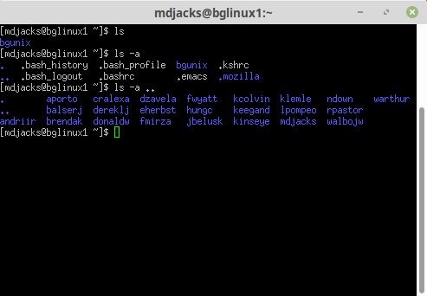
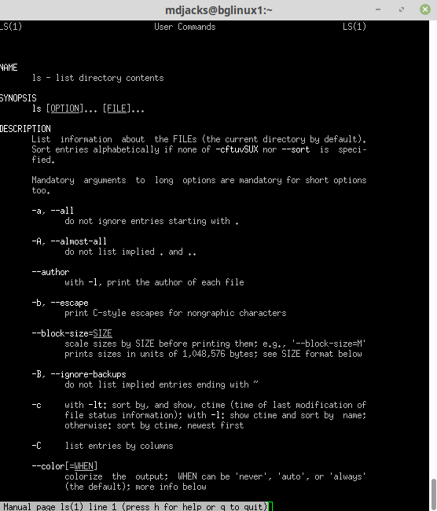
Our First Command
$ ls
$ ls -a
$ ls -a ..

Slide 5
Man Pages
$ man command
Try running:
$ man ls
BGSU Linux Club

Slide 6
Common Commands
$ ls -switch | Lists the files of the current directory -a lists all files including hidden files
$ mkdir argument | Makes a directory called ‘argument’
$ cat argument | Concatenates the argument to standard out
$ pwd | Prints the working directory
$ cd argument | Change directory. If ran without arguments takes you back to home (~)
$ rmdir (or $ rm –r) argument | Removes directory named ‘argument’. rmdir will not delete a non-empty directory.
$ sudo argument | Runs the given argument with super user privileges (super user do argument). Be careful with this.
$ cp –switch argument1 argument2 $ mv –switch argument1 argument2 | Copy a file to a location Move argument1 to argument2
Note, almost all commands by default output to standard out (the terminal in this case), but can be piped into files or other programs using > (overwrite) or >> (append).
BGSU Linux Club

Slide 7
Text Editing
Open a file using nano:
$ nano file
From there you can type as normal
Save by using ctrl-x and following the prompts
BGSU Linux Club

Slide 8
Text Editing
Open a file using vim (or neovim):
$ vim file or nvim file
You’ll notice that you can’t type immediately.
Vim uses different modes to determine what you wish to do. These include normal, insert, visual, and replace.
Enter insert mode by pressing i, then you can type as normal.
To leave insert mode press escape.
Save by pressing `:` to start a command then entering `w` to write the file, like so:
:w
To quit enter :q
Commands can be chained like so :wq to save and quit.
BGSU Linux Club

Slide 9
Text Editing
Open a file using emacs:
$ emacs file
From there you’re on your own. Emacs is a beast of a piece of software, but if you can get good at using it then you can do anything in Emacs.
BGSU Linux Club

Slide 10
Text Editing
nano | Recommended for beginners. Really easy to get simple things done with. Cumbersome to actually use daily.
(n)vim | Actually recommended for daily use. Can be made into an IDE with extensions
emacs | A full fledged IDE/LaTeX editor. I used it for math one semester. Would not recommend unless you really want to use it.
BGSU Linux Club

Slide 11
Let’s Get Hands On!
Create a directory
Create a file in that directory
Write something in the file
Print that document to the terminal
Delete the file
Delete the directory

Slide 12

Apply What We’ve Learned
Put your terminal skills to the test with
Terminus!
bit.ly/2SywXVb

Slide 13
File Structure
/ | Root directory
/home | Folder of home folders
/etc | Generally where configuration files are stored
/var | Variable data (databases, logs)
/usr | User installed programs
/bin | Coreutils (the really important programs)
/tmp | Temporary files (sometimes cleared on boot)
/mnt | Temporary location to mount external disks
/boot | Kernel, bootloader, EFI stubs
~ | Reference to your home folder
Root

Slide 14
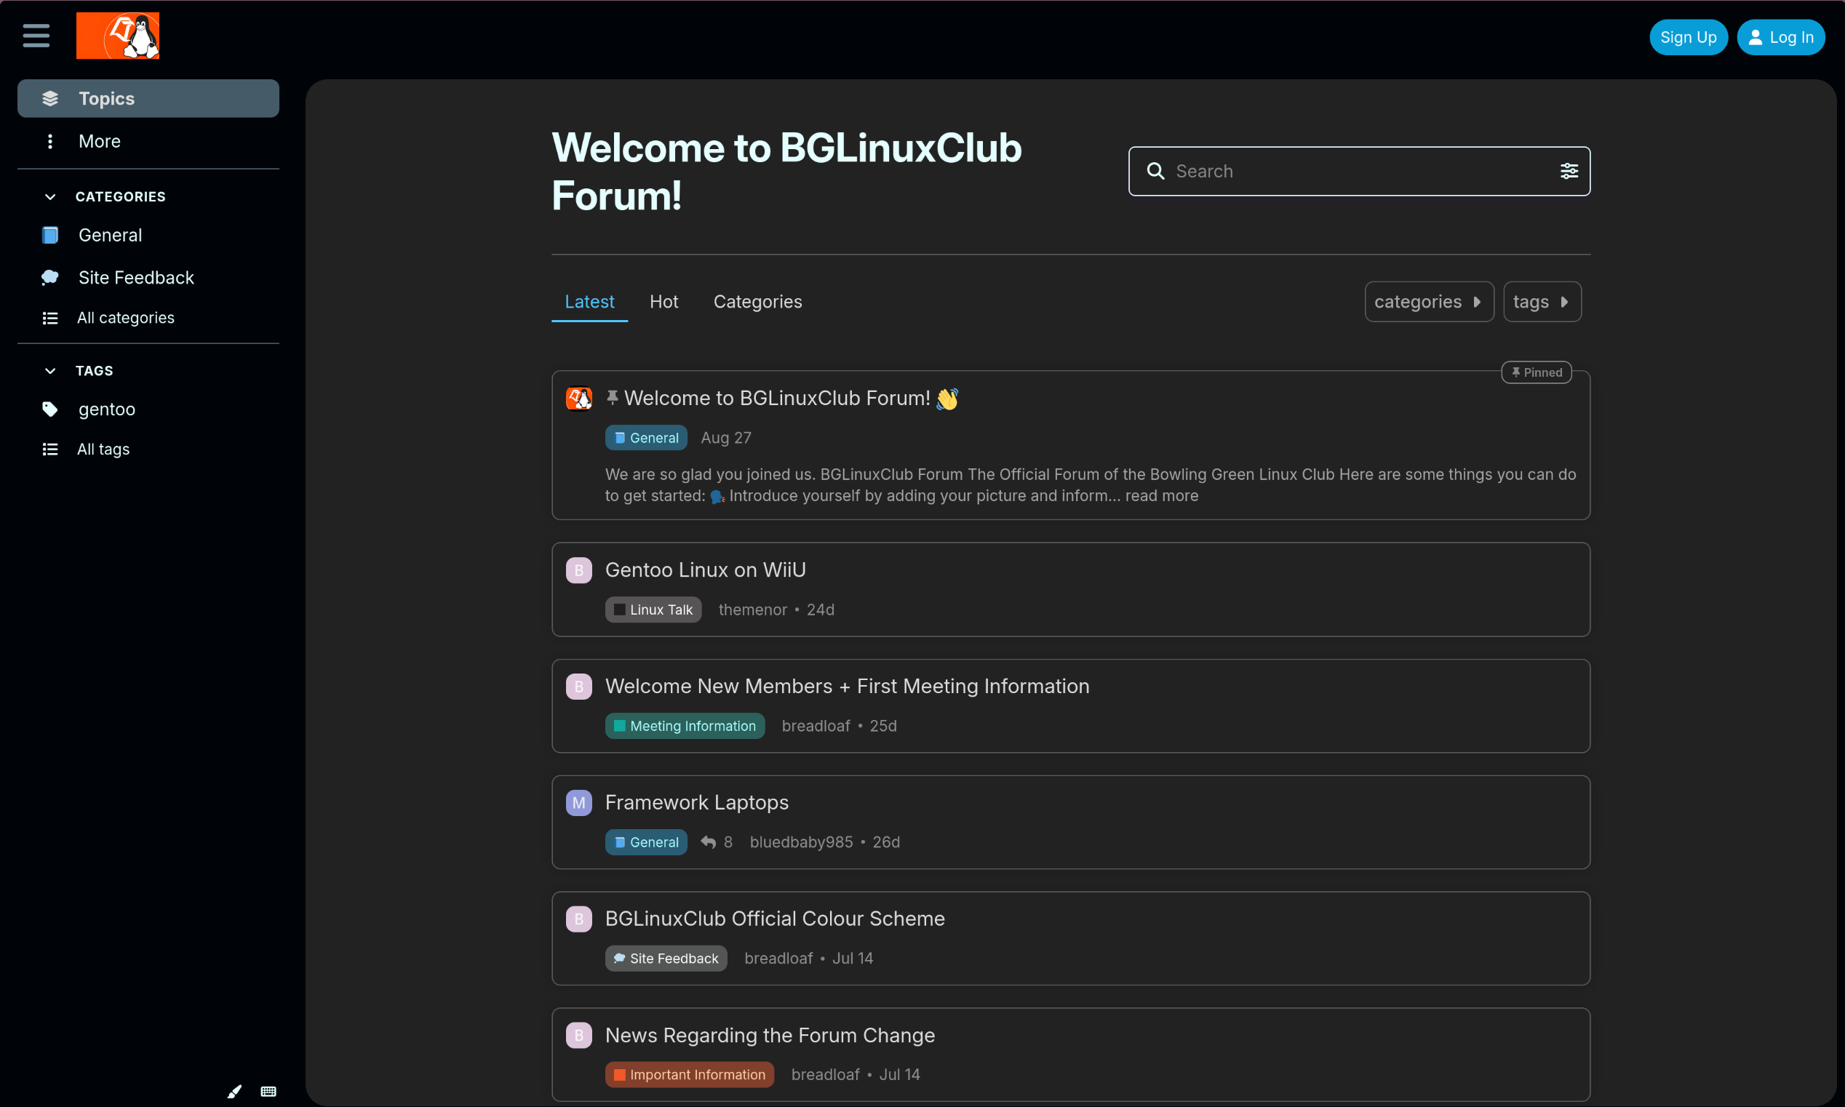
Our Forum!

Slide 15
Our Forum!
How do I join in?
Go to forum.bglinux.club and click ‘Sign Up’ in the top right
You’re open to discuss anything you wish, even non-Linux related things. (i.e. homework, programming, food)
Feel free to browse the forum even without logging in

Slide 16
Thank you!
Connect with us!
Meetings | Thursdays 7:00 – 9 PM BTSU 314
Git | git.bglinux.club
Forum | forum.bgilunx.club

